Slide 1

Health and Fitness Tracker

Slide 2
Introduction
In today’s fast-paced world, maintaining a healthy lifestyle has become increasingly challenging. With rising concerns about obesity, heart disease, and sedentary habits, individuals are seeking innovative ways to monitor and improve their health. This is where a Health and Fitness Tracker emerges as a powerful tool, enabling users to take control of their wellness journey. A Health and Fitness Tracker is a digital system that monitors and analyzes an individual’s physical activity, calorie intake, and other health parameters.

Slide 3
Key Features of Health and Fitness Trackers
Workout Logging and Monitoring :
This feature is used allow user to login the website of Health and Fitness Tracker.
Fitness Insights :
This is used to allow used user to enter height, weight to get the progress note.
Calorie Logs: The user is used enter the meal items and Quantity

Slide 4
Key Benefits of Your Health and Fitness Tracker
Data-Driven Decision Making
With data collected across fitness insights, calorie logs, and workout sessions, users can make informed decisions about their fitness journey. These insights allow users to identify trends, set realistic goals, and adjust their workout and diet plans accordingly.

Slide 5
Personalized Fitness Recommendations
Using aggregated data from the three tables, the tracker can offer personalized recommendations to users.
For instance:If a user logs high-calorie intake without sufficient workouts, the tracker can suggest increasing physical activity.
If BMI trends indicate stagnation, the system can recommend modifications to diet and workout intensity.Enhanced Goal Tracking and Motivation

Slide 6
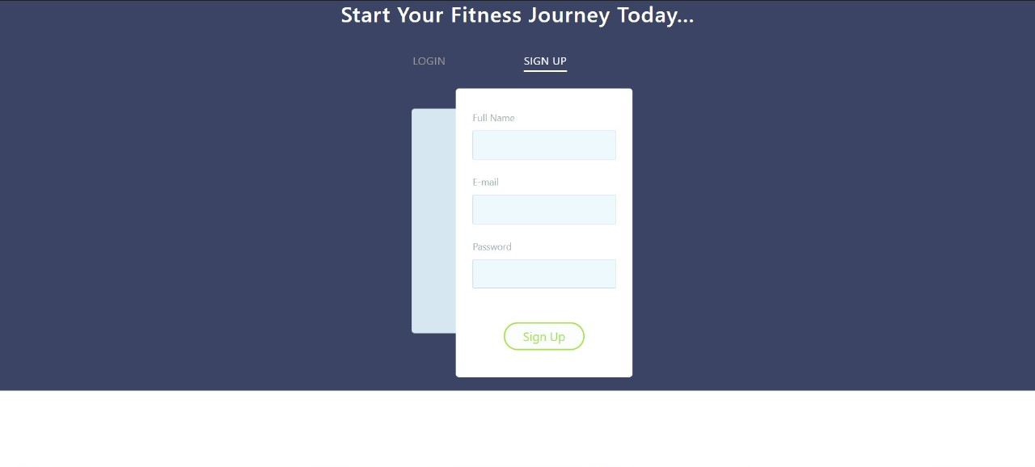
Login Sign Up

Slide 7
Short-term Goals: Track daily calorie intake and expenditure.
Long-term Goals: Monitor progress in BMI, weight, and overall fitness.Visual progress reports and goal completion milestones encourage users to stay consistent and motivated.Improved Calorie Management and Weight Control
Accurate calorie tracking ensures that users can maintain a calorie deficit or surplus, depending on their goals.Comparing calorie intake with calories burned gives users insights into maintaining an optimal balance between diet and exercise.Holistic Health Analysis with Progress Trends

Slide 8
Longitudinal data from FitnessInsights enables users to observe trends and identify areas for improvement.Visualizing progress through graphs and charts helps users stay engaged and focused on their fitness journey.

Slide 9
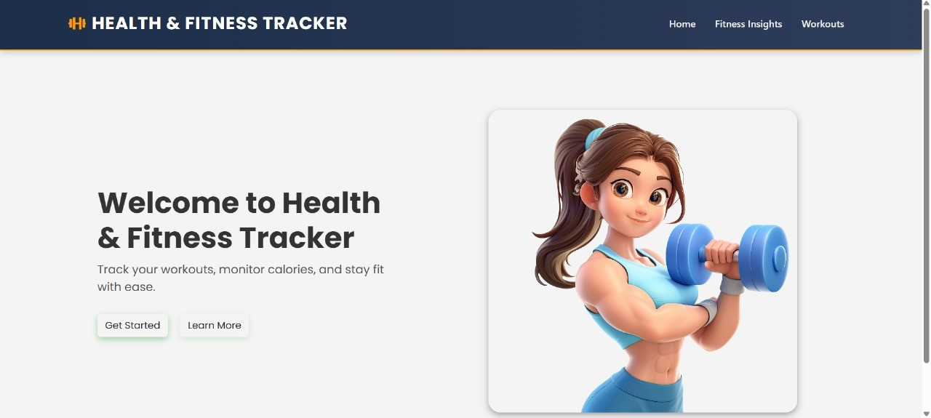
Homepage

Slide 10
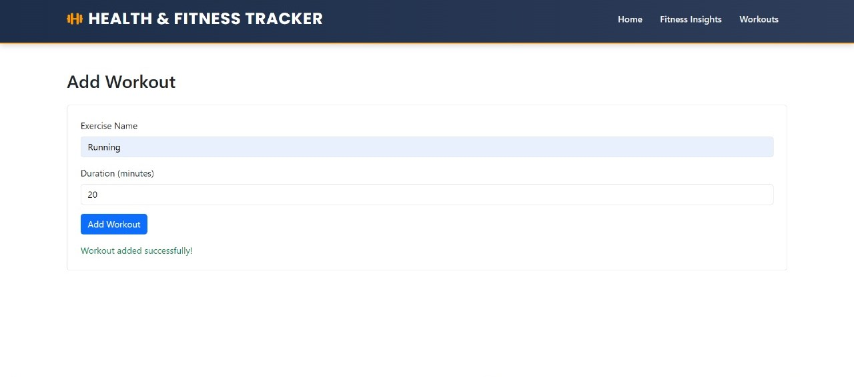
Add WorkOut Page

Slide 11
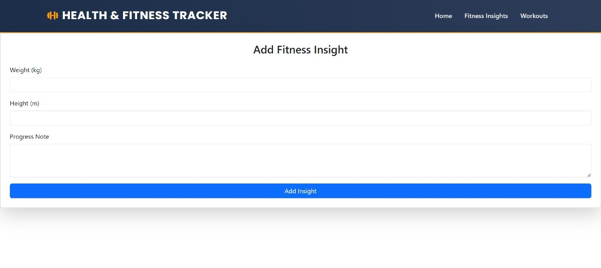
Fitness Insight Page

Slide 12
Future Enhancements:- AI-Based Recommendations:Use Machine Learning to predict calorie intake trends and suggest workout adjustments.Recommend personalized workout routines based on past performance and progress.
✅ Automated Alerts and Reminders:Send notifications to remind users about missed workouts, high-calorie intake, or hydration needs.
✅ Gamification and Challenges:Introduce challenges and leaderboards to promote friendly competition and increase engagement.

Slide 13
Frontend And backend Technologies
BACK END IDE DATABASE - SQL SERVER - version18/19
VISUAL STUDIO - 2022 - DOTNET CORE the version used is 6.0
C# 8.0
DOTNET CORE - version :6.0
ASP.NET CORE WEB API - RESTFRONT END
IDE VS CODEFORNTEND
REACTJS - 19

Slide 14
Thank You

